Slide 1
Effective Division Council Meetings
District 84 Leadership Training
2023-2024 Program Year
By Paula Summa, DTM

Slide 2
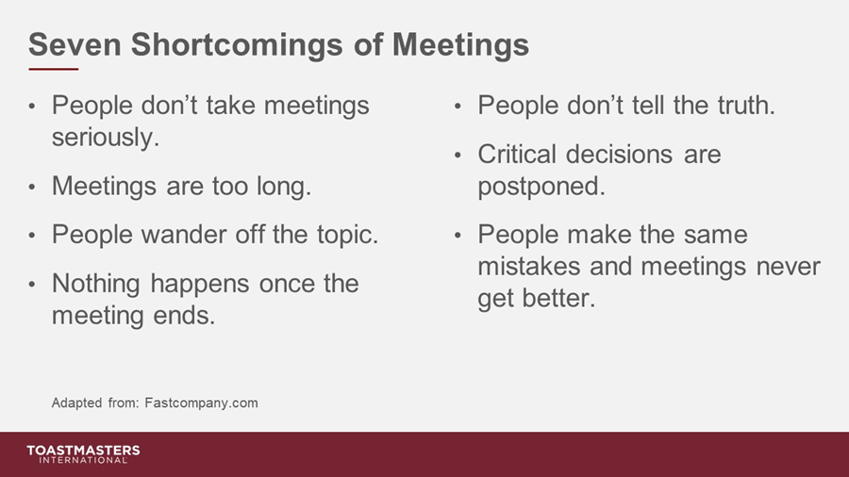

Slide 3



Identify
Recognize
Develop
Who:
Division Director
Area Directors
Assistant DDs & ADs
Any additional “Chairs”
What & Why:
Manages Division activities
Facilitates the achievement of club, Area, Division, and District goals
Helps with administrative activities, such as Division contests, meetings, training and conference
Leads and Motivates
Where & When:
Optimal: Monthly meetings/In Person or On-Line
Suggested: Quarterly
TI Required: At Least TWICE a Year

Slide 4


STRATEGICALLY PLAN YOUR MEETINGS
How often will team meet?
What will main method of communication be?
How will members be accountable for their responsibilities?
How will decisions be made?
How will team ensure equitable participation?

Slide 5


Slide 6
Positive Discussions Include:
Area Success Plans/Progress in Distinguished Area Program
Club Success Plans/Progress in the Distinguished Club Program
Club officer training (TLI)
Membership Building Ideas
Division or Area wide Guest Speakers
Plans for Division events, such as training and speech contests
Plans for District events, such as speech contests, conference
In other words:
The Leaders in the Division work as a TEAM to help each other help clubs achieve success!

Slide 7
Communication + Accountability + Camaraderie = EFFECTIVE DIVISION COUNCIL MEETINGS
Identify
Recognize
Develop
Barriers
Common Concerns
Communication Styles
Leadership Styles
Core Values
Expectations
Best Practices
Strategies
Areas of Responsibilities
Recognition
Common values & goals
Potential
Passion
Experience
Knowledge
Skills
Motivation
Notes:
Our objectives will be to first, learn to identify what a successful club visit looks like and to recognize the various outcomes of our visit so that we can develop strategies that will help ensure that we hold productive and successful club visits

Slide 8
How Do Team Leaders Motivate Teams:
Understand the needs of the teams
Use encouraging words
Recognize them for their efforts and accomplishments
Set clear expectations
Be a positive role model

Slide 9
Division Director Resources:
How to build a Toastmasters Club
Club Leadership Handbook
Toastmasters International District Recognition Program
Division Success Plan
District Leadership Handbook
Distinguished Club Program and Club Success Plan
Speech Contest Rulebook
Training Club Leaders
Club Status Guide
Dashboard Quick Guide
Notes:
ivision Director resources
How to build a Toastmasters Club
Club Leadership Handbook
Toastmasters International District Recognition Program
Division Success Plan
District Leadership Handbook
Distinguished Club Program and Club Success Plan
Speech Contest Rulebook
Training Club Leaders
Club Status Guide
Dashboard Quick Guide

Slide 10
Questions?
Thank you!

